Slide 1





NEXT GEN EMPLOYABILITY PROGRAM
Creating a future-ready workforce
Student Name: P.Jayasuriya
Student Reg _No: 110321104020
Student ID : au110321104020
Student Email: suriyajaya575@gmail.com
College Name
GRT INSTITUTE OF ENGINEERING AND TECHNOLOGY

Slide 2

CAPSTONE PROJECT SHOWCASE
Next Gen Employability Program
Project Title
MUSIC WEB APPLICATION USING DJANGO FRAMEWORK
Abstract | Problem Statement | Project Overview | Proposed Solution | Technology Used | Modelling & Results | Conclusion

Slide 3
Next Gen Employability Program
Abstract
User Account Creation and Login:
  Users create accounts, similar to other music platforms.
  After successful login, they are redirected to the home page.
Song Search and Playback:
  On the home page, users can search for songs based on their preferences.
  An API fetches song data, allowing users to explore and play their favorite tracks.
Song Management and Display:
  Users can add songs to their collection.
  Corresponding song images are displayed on the home page.
Admin Panel Integration:
  The application’s login system is managed through the admin panel

Slide 4
Next Gen Employability Program
Problem Statement
User Registration and Login:
  Create an account system where users can register and log in.
  Upon successful login, users should be redirected to the home page.
Song Management:
  Implement a search feature for songs based on user preferences.
  Utilize an API to fetch songs and display them on the home page
Song Details and Images:
  Display corresponding images related to each song on the home page.
  Enable users to easily play the songs directly from the web application.
Admin Panel Integration:
  Manage the login system and user authentication through the Django admin panel.

Slide 5
Next Gen Employability Program
Project Overview
Identifying Project Goals:
  Define clear objectives and outcomes for the project.
  Specify what needs to be achieved and why it matters.
Scope Definition:
  Clearly outline the boundaries of the project.
  Identify what is included and excluded from the project scope.
Resource Allocation and Constraints:
  Determine available resources (such as budget, time, and personnel).
  Highlight any limitations or constraints that might impact project execution.
Stakeholder Communication:
  Establish effective communication channels with project stakeholders.
  Ensure alignment between project team members, sponsors, and end-users.

Slide 6
Next Gen Employability Program
Proposed Solution
Problem Context and Importance:
  Context: Our goal is to create a music web application where users can discover, play, and manage songs.
  Importance: Music applications enhance user experience, provide entertainment, and allow artists to
showcase their work. Solving this problem benefits music enthusiasts and artists alike.
High-Level Approach:
  User Registration and Login:
    Implement user registration and login functionality.
    Create user accounts and securely manage authentication.
  Song Management:
    Develop a search feature for songs based on user preferences.
    Utilize an external API (e.g., Last.fm or Spotify) to fetch song data

Slide 7
Next Gen Employability Program
Song Details and Images:
Display song details (title, artist, album) along with corresponding images.
Enable users to play songs directly from the web application.
Admin Panel Integration:
Use Django’s admin panel for managing users, songs, and other app-related data.
Implementation Steps:
Project Setup:
Create a new Django project (music_player_project).
Set up necessary folders and apps (e.g., api and music_player_app).
Data Models:
Define a Song model in the api app with fields for title, category, artist, audio file, and audio image.
Extend the default Django user model in the music_player_appapp to include additional fields (e.g., groups, permissions).

Slide 8
Next Gen Employability Program
User Actions:
  Allow users to add songs to their playlist.
oEnable song playback directly within the app.
  Admin Panel:
oUse Django’s built-in admin panel for managing users and songs.
4.Risk Assessment and Mitigation:
Technical Risks:
oEnsure robust error handling for API requests and database interactions.
oRegularly test and debug the application.
User Adoption Risks:
oCommunicate effectively with users during registration and login.
oProvide clear instructions for using the app’s features.

Slide 9


Next Gen Employability Program
Technology Used
Front-end
Back-end
Source :

Slide 10
Next Gen Employability Program
Modelling & Results
Problem Context and Importance:
  Context: In the field of machine learning and mathematical modeling, understanding the
problem context is crucial.
  Importance: Accurate modeling and insightful results drive decision-making, optimization, and scientific advancements.
Defining the Problem:
  Ideal Outcome: Clearly state the desired outcome. What specific question or challenge are you addressing?
  Model’s Goal: Define the purpose of your model. Is it for prediction, classification, regression, or optimization?
  Output: Identify what the model will produce (e.g., predictions, probabilities, recommendations).

Slide 11
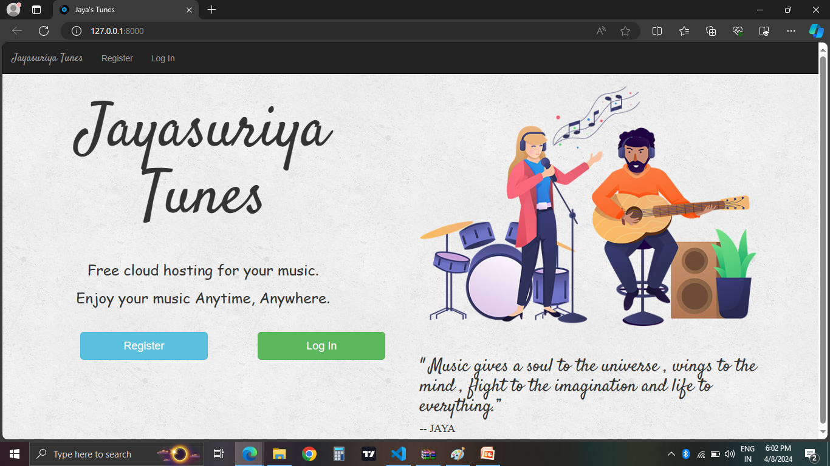
Homepage
Next Gen Employability Program

Slide 12
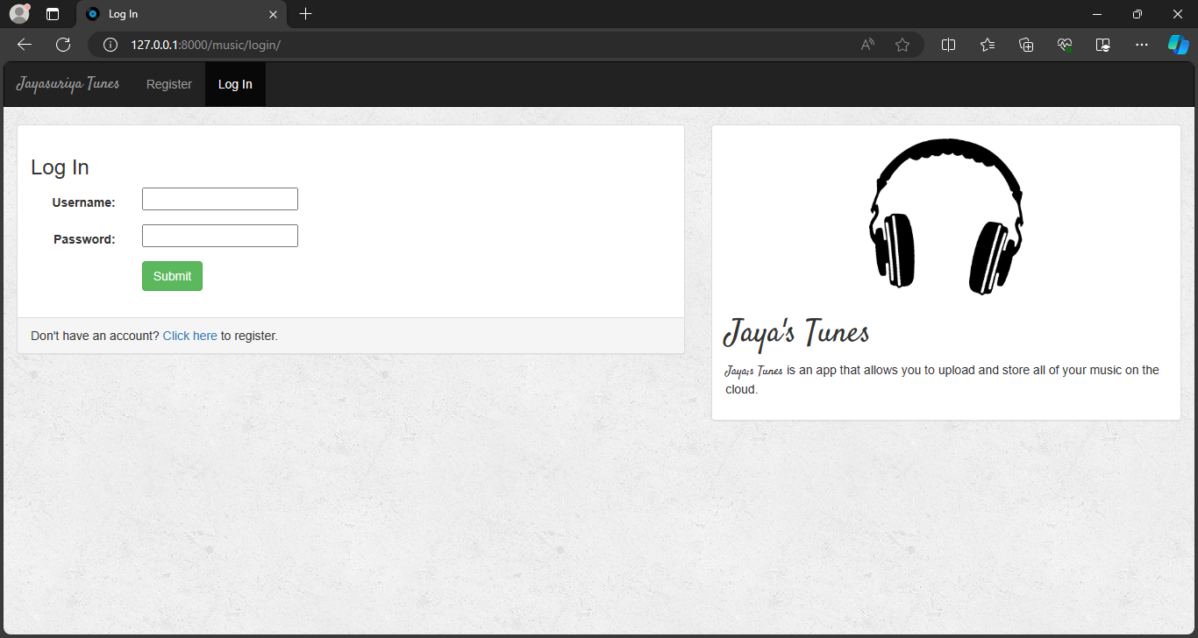
Next Gen Employability Program
Login-Page

Slide 13
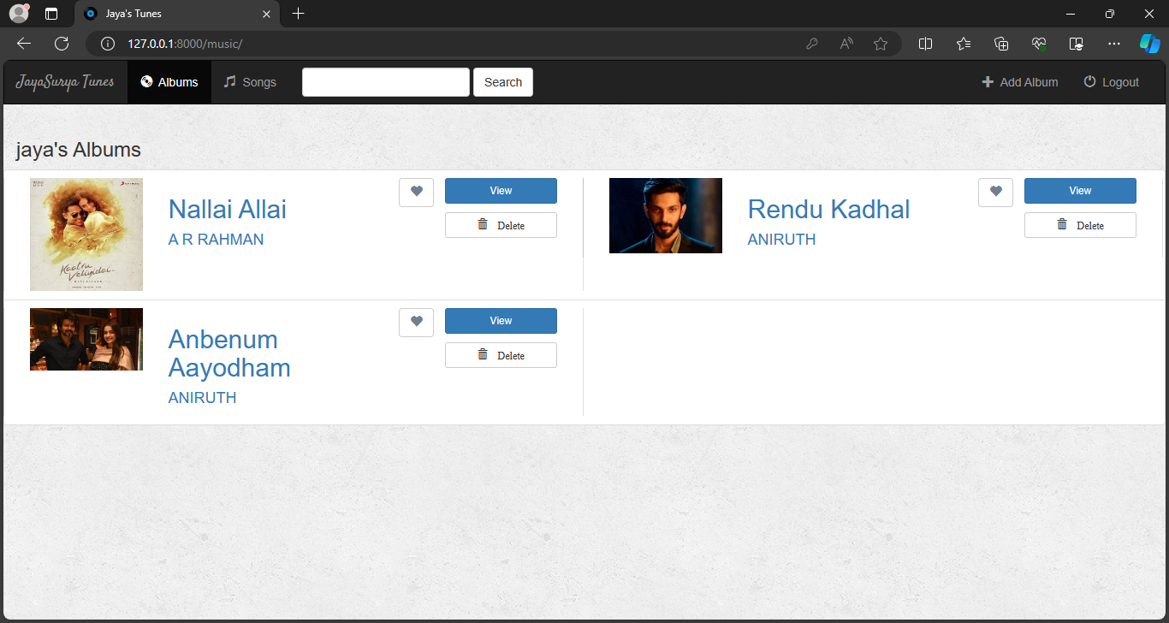
Next Gen Employability Program
Album-Page

Slide 14
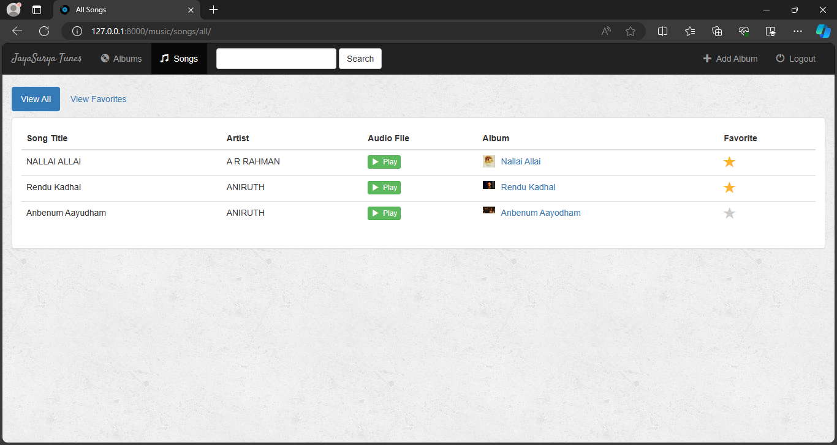
Next Gen Employability Program
Songs-Page

Slide 15
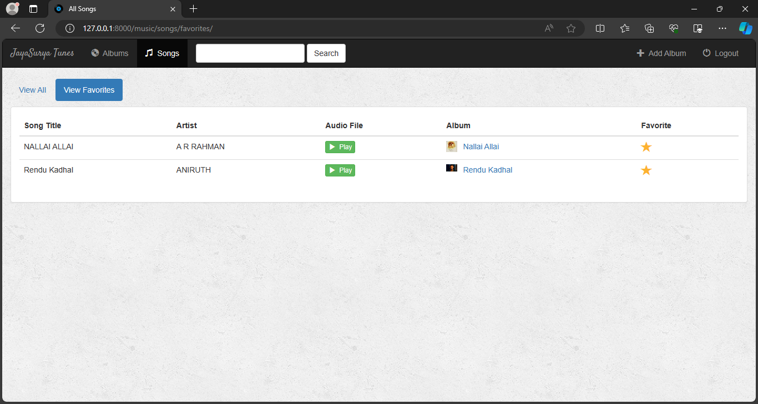
Next Gen Employability Program
Favorite-Page

Slide 16
Next Gen Employability Program
Future Enhancements:
Problem Context and Importance:
  Context: As technology evolves, software systems and applications need continuous improvement.
  Importance: Identifying future enhancements ensures that your solution remains relevant, efficient, and competitive.
Defining the Problem:
  Current State: Describe the existing system or application. What features or functionalities are already in place?
  Gaps and Opportunities: Identify areas where improvements or additional features are needed.
  User Needs: Consider feedback from users, stakeholders, and market trends.
3. Future Enhancement Goals:
Clear Objectives: Specify what you aim to achieve with these enhancements.
Prioritization: Determine which enhancements are most critical or impactful.

Slide 17
Next Gen Employability Program
Conclusion
Problem Context and Importance:
  Context: The conclusion of any research or project marks the final stage where you summarize your findings and insights.
  Importance: Crafting an effective conclusion ensures that your work leaves a lasting impression and provides closure.
Defining the Problem:
  Restate the Problem: Begin by revisiting the problem or research question addressed in your work.
  Summarize Arguments or Findings: Briefly recap the key arguments, results, or discoveries presented throughout your paper.
Key Goals of the Conclusion:
  Reinforce the Problem Significance: Remind readers why the problem matters and why your investigation is relevant.

Slide 18
Thank You!
Next Gen Employability Program

